Slide 1

Comparison of Web Page Classification Algorithms
The objective of our final project is to evaluate several supervised learning algorithms for identifying pre-defined classes among web documents.
Presented by
Yi Cheng, Jianye Ge, Jun Liang, Sheng Yu

Slide 2
Project Outline
Problem Statement
Literature Review
Project Design
Implementation
Results & Comparison

Slide 3
Problem Statement
Why Web Page Classification
Supervised or Unsupervised Classification
Classification Accuracy
Classification Efficiency

Slide 4
Literature Review –Web Categorization
Arul Prakash Asirvatham etc. (2000) reviewed web categorization algorithms. Major classification applications have been divided into five classes:
(1) Supervised classification, or so called manual categorization. This is useful when classes has been predefined.
(2) Unsupervised, or Clustering approaches. Clustering algorithms can group web documents without any pre-defined framework, or background information. Most clustering algorithms, such as K-means, need to set the number of cluster in advance. And computational time is expensive here.

Slide 5
Literature Review –Web Categorization
(3). Meta tags based categorization. Using meta tag attributes for web documents classification. The assumption that author of document will use correct keywords in the meta tags is not always true.
(4) Text content based categorization. A database of keywords in a category is prepared and commonly occurring words (called stop words) are removed from this list. The remaining words can be used for classification. K-Nearest Neighbor classification algorithm.
(5) Link and content analysis, or hub-authority analysis. The link-based approach is an automatic web page categorization technique based on the fact that a web page that refers to a document must contain enough hints about its content to induce someone to read it.

Slide 6
Literature Review --Supervised Classification
Given a set of example records
  Each record consists of
    A set of attributes
    A class label
Build an accurate model for each class based on the set of attributes
Use the model to classify future data for which the class labels are unknown

Slide 7
Literature Review– Supervised Classification Model
Neural networks
Statistical models – linear/quadratic discriminants
Decision trees
Genetic models

Slide 8
Literature Review-- Naïve Bayes Algorithm
A straightforward and frequently used method for supervised learning.
Provides a flexible way for dealing with any number of attributes or classes, based on probability theory of Bayes’s rule.
The asymptotically fastest learning algorithm that examines all its training input.
Performs surprisingly well in a very wide variety of problems in spite of the simplistic nature of the model.
Small amounts of “noise” do not perturb the results by much.

Slide 9
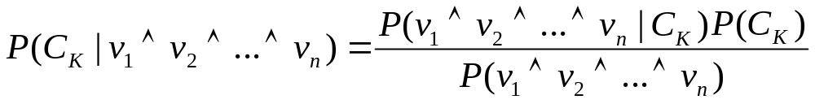
Literature Review-- Naïve Bayes Algorithm
How it works
  Suppose Ck are classes which the data will be classified into.
  For each class, P(Ck) represents the prior probability of classifying an attribute into Ck, and it can be estimated from the training dataset.
  For n attribute values Vj ( j=1…n ), the goal of classification is clearly to find the conditional probability P(Ck|V1^V2^...^Vn). By Bayes’s rule,
  For classification, the denominator is irrelevant, since for given values of the Vj, it is the same regardless of the value of Ck.

Slide 10
Literature Review-- Decision Tree Classification
Relatively fast compared to other classification models
Obtain similar and sometimes better accuracy compared to other models
Simple and easy to understand
Can be converted into simple and easy to understand classification rules

Slide 11
Literature Review-- Decision Tree Classification
A decision tree is created in two phases:
  Tree Building Phase
    Repeatedly partition the training data until all the examples in each partition belong to one class or the partition is sufficiently small
  Tree Pruning Phase
    Remove dependency on statistical noise or variation that may be particular only to the training set

Slide 12
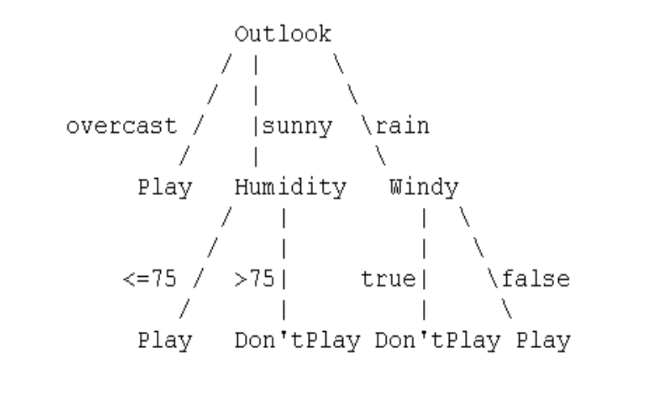
Literature Review-- Decision Tree Classification
The ID3 algorithm is used to build a decision tree, given a set of non-categorical attributes C1, C2, .., Cn, the categorical attribute C, and a training set T of records.
The basic ideas behind ID3 are that:
In the decision tree each node corresponds to a non-categorical attribute and each arc to a possible value of that attribute. A leaf of the tree specifies the expected value of the categorical attribute for the records described by the path from the root to that leaf.
Entropy is used to measure how informative is a node.

Slide 13
Literature Review-- Decision Tree Classification
C4.5 is an extension of ID3 that accounts for unavailable values, continuous attribute value ranges, pruning of decision trees, rule derivation, and so on.
In building a decision tree we can deal with training sets that have records with unknown attribute values by evaluating the gain, or the gain ratio, for an attribute by considering only the records where that attribute is defined.
In using a decision tree, we can classify records that have unknown attribute values by estimating the probability of the various possible results.

Slide 14
Project Design
Searching for web page set based on a topic
Defining the categories by observation
Three categories 1-clothes, 2-computer, 3-food
Generating the training set based web page set
Random download web pages, some for each category
Define keywords for each category
Building up the training set
Use 30 keywords 80 records
Automatically done by program
Building up categories and decision tree
Naïve Bayes
Decision Tree
Classifying the test set of new web pages

Slide 15
Implementation
Java 2 Application
Topic - Apple
A Java Program for building up a training set
Classification Algorithms are based on Weka
Classification based on Naïve and Decision Tree
Weka Java Package

Slide 16
What is Weka?
Java package developed at the University of Waikato in New Zealand. “Weka” stands for the Waikato Environment for Knowledge Analysis.
Weka is a collection of machine learning algorithms for solving real-world data mining problems. The algorithms can either be applied directly to a dataset or called from your own Java code.
Weka contains tools for data pre-processing, classification, regression, clustering, association rules, and visualization. It is also well-suited for developing new machine learning schemes. Weka is open source software issued under the GNU General Public License.

Slide 17
Processing Training and Test Data Set
Two steps processing implemented by Java
1. Keywords vector space generating
All web documents collected for each category have been defined as input training sets and processed with java program. The input for the java program are two – one is the training set, the other is keywords index file. Keywords are decided based on the properties of each category. The result is a matrix. Row variable is individual file, and column variable is keyword. Cell value is the frequency of each keyword appeared in individual document.
2. Conversion to ARFF format
ARFF format is the standard input for Weka program package. Examples see the executing of our sample data.

Slide 18
Result of Decision Tree
Result of Decision Tree
Training :
computer <= 0
| power <= 3
| | recipe <= 0
| | | power <= 0
| | | | shop <= 2: 1 (7.0)
| | | | shop > 2: 3 (3.0)
| | | power > 0: 3 (4.0/1.0)
| | recipe > 0: 3 (21.0)
| power > 3: 1 (3.0/1.0)
computer > 0
| jeans <= 0: 2 (39.0)
| jeans > 0: 1 (5.0)
Number of Leaves : 7
Size of the tree : 13
Training Set Quality:
a b c <-- classified as
14 0 1 | a = 1
1 39 0 | b = 2
0 0 27 | c = 3
Test Set Result:
a b c <-- classified as
5 4 0 | a = 1
1 12 4 | b = 2
2 0 14 | c = 3
Three categories: 1-clothes, 2-computer, 3-food

Slide 19
Result of Naïve Bayes
Three categories: 1-clothes, 2-computer, 3-food
Result of Decision Tree
Training :
Class 1: Prior probability = 0.19
Class 2: Prior probability = 0.48
Class 3: Prior probability = 0.33
For each keyword Normal Distribution Mean, StandardDev,
WeightSum, Precision
Training Set Quality:
a b c <-- classified as
15 0 0 | a = 1
2 38 0 | b = 2
3 0 24 | c = 3
Test Set Result:
a b c <-- classified as
9 0 0 | a = 1
7 9 1 | b = 2
0 0 16 | c = 3

Slide 20
Comparison of two classifiers
Naïve Bayes Classifier has better overall performance, compared to decision tree.
Correctly Classified Instances Percentage
Naïve Bayes 34 80.9524 %,
Decision Tree 31 73.8095 %.
(Total Test Set 42, training set 82).
2. Naïve Bayes perform better in classe1 and 3, but not in 2
Decision tree performs better in class 2 and 3 , but not in class 1
They both perform good in class 3. See results.
  Class 1-clothes, 2-computer, 3-food

Slide 21
References
1. Heide Brücher, Gerhard Knolmayer, Marc-André Mittermayer, Document Classification Methods for Organizing Explicit Knowledge, http://www.ie.iwi.unibe.ch/, 2002
2. Y. Bi, F. Murtagh, S. McClean and T.Anderson, Text Passage Classification Using Supervised Learning, http://ir.dcs.gla.ac.uk/lumis99/papers/bi.pdf, 1999
3. Soumen Chakrabarti, Mining the Web, Morgan Kaufmann Publishers, 2003
4. Dumais, S.T., Platt, J., Heckerman, D., and Sahami, M., Inductive Learning Algorithms and representations for text categorization, Proceedings of the Seventh International conference on Information and Knowledge Management (CIKM’98), pp.148-155, 1998.
5. Arul Prakash Asirvatham, Kranthi Kumar. Ravi, Web Page Categorization based on Document Structure, 2000.

